Slide 1
Power in the Field
Curtis V. Macchioni
SJAA, June 25, 2022

Slide 2
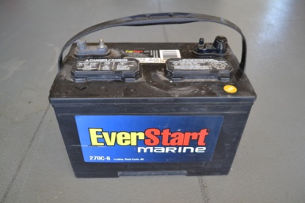
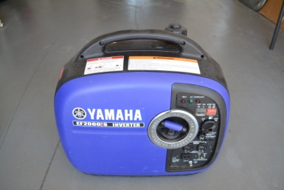
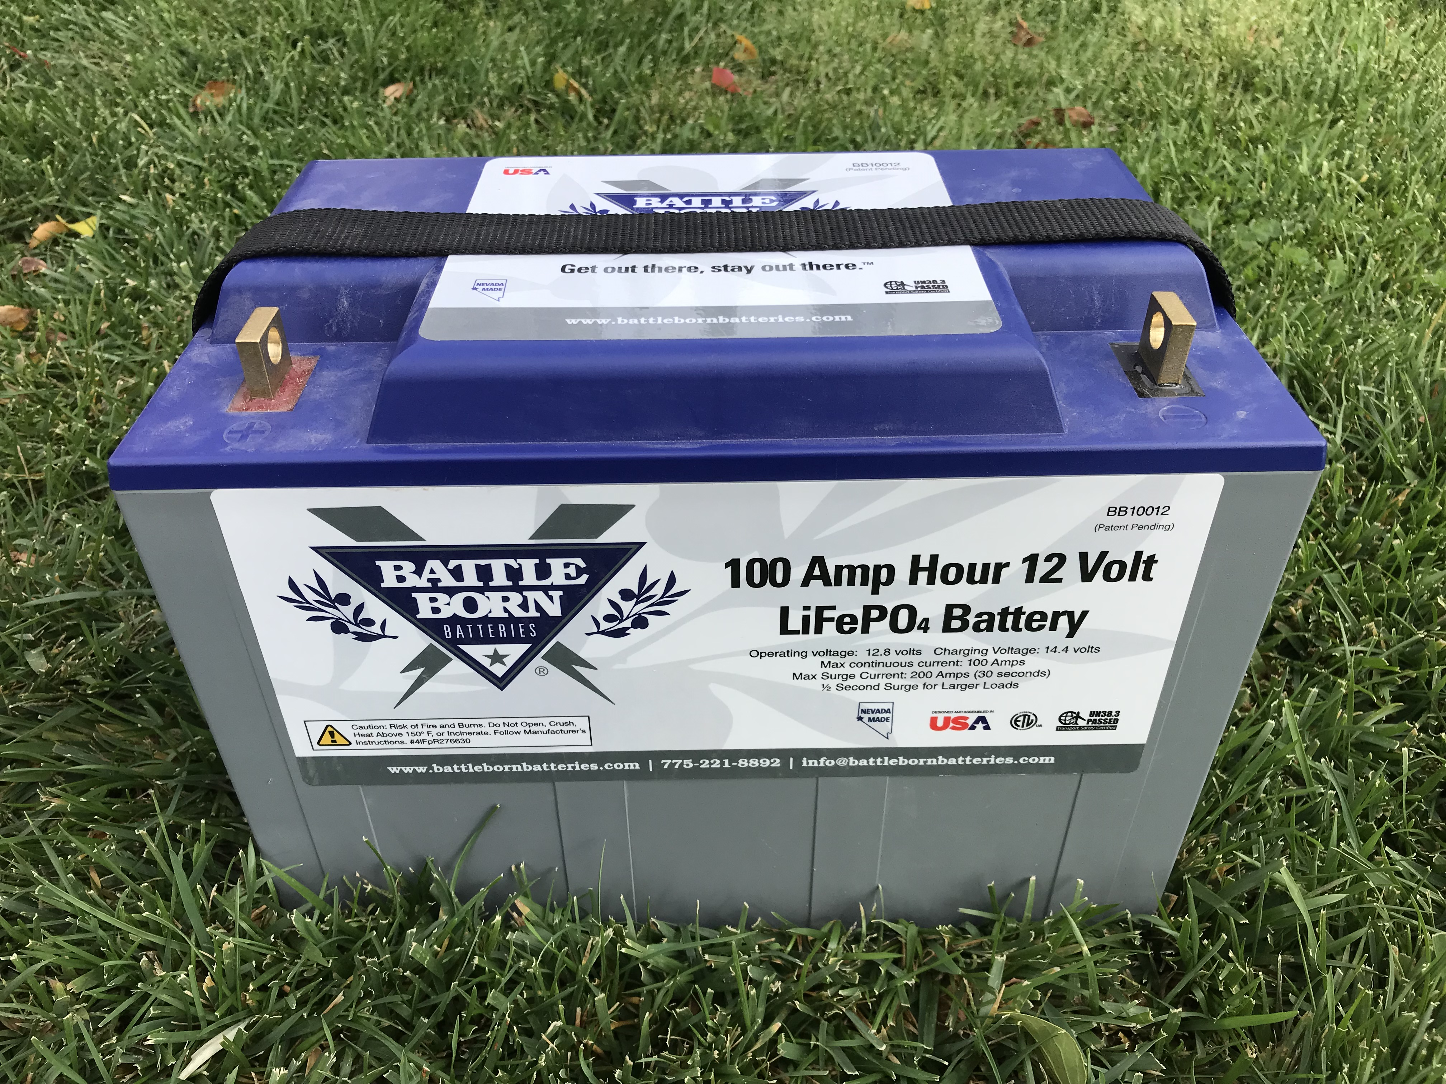
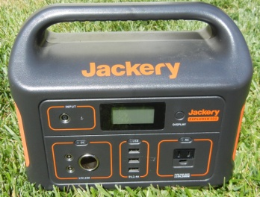
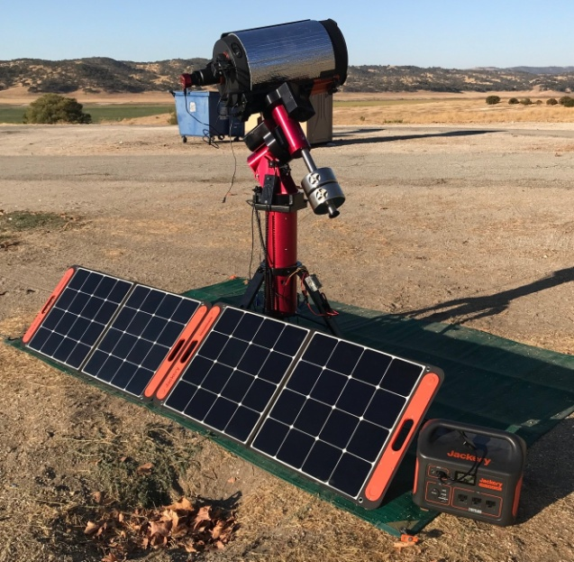
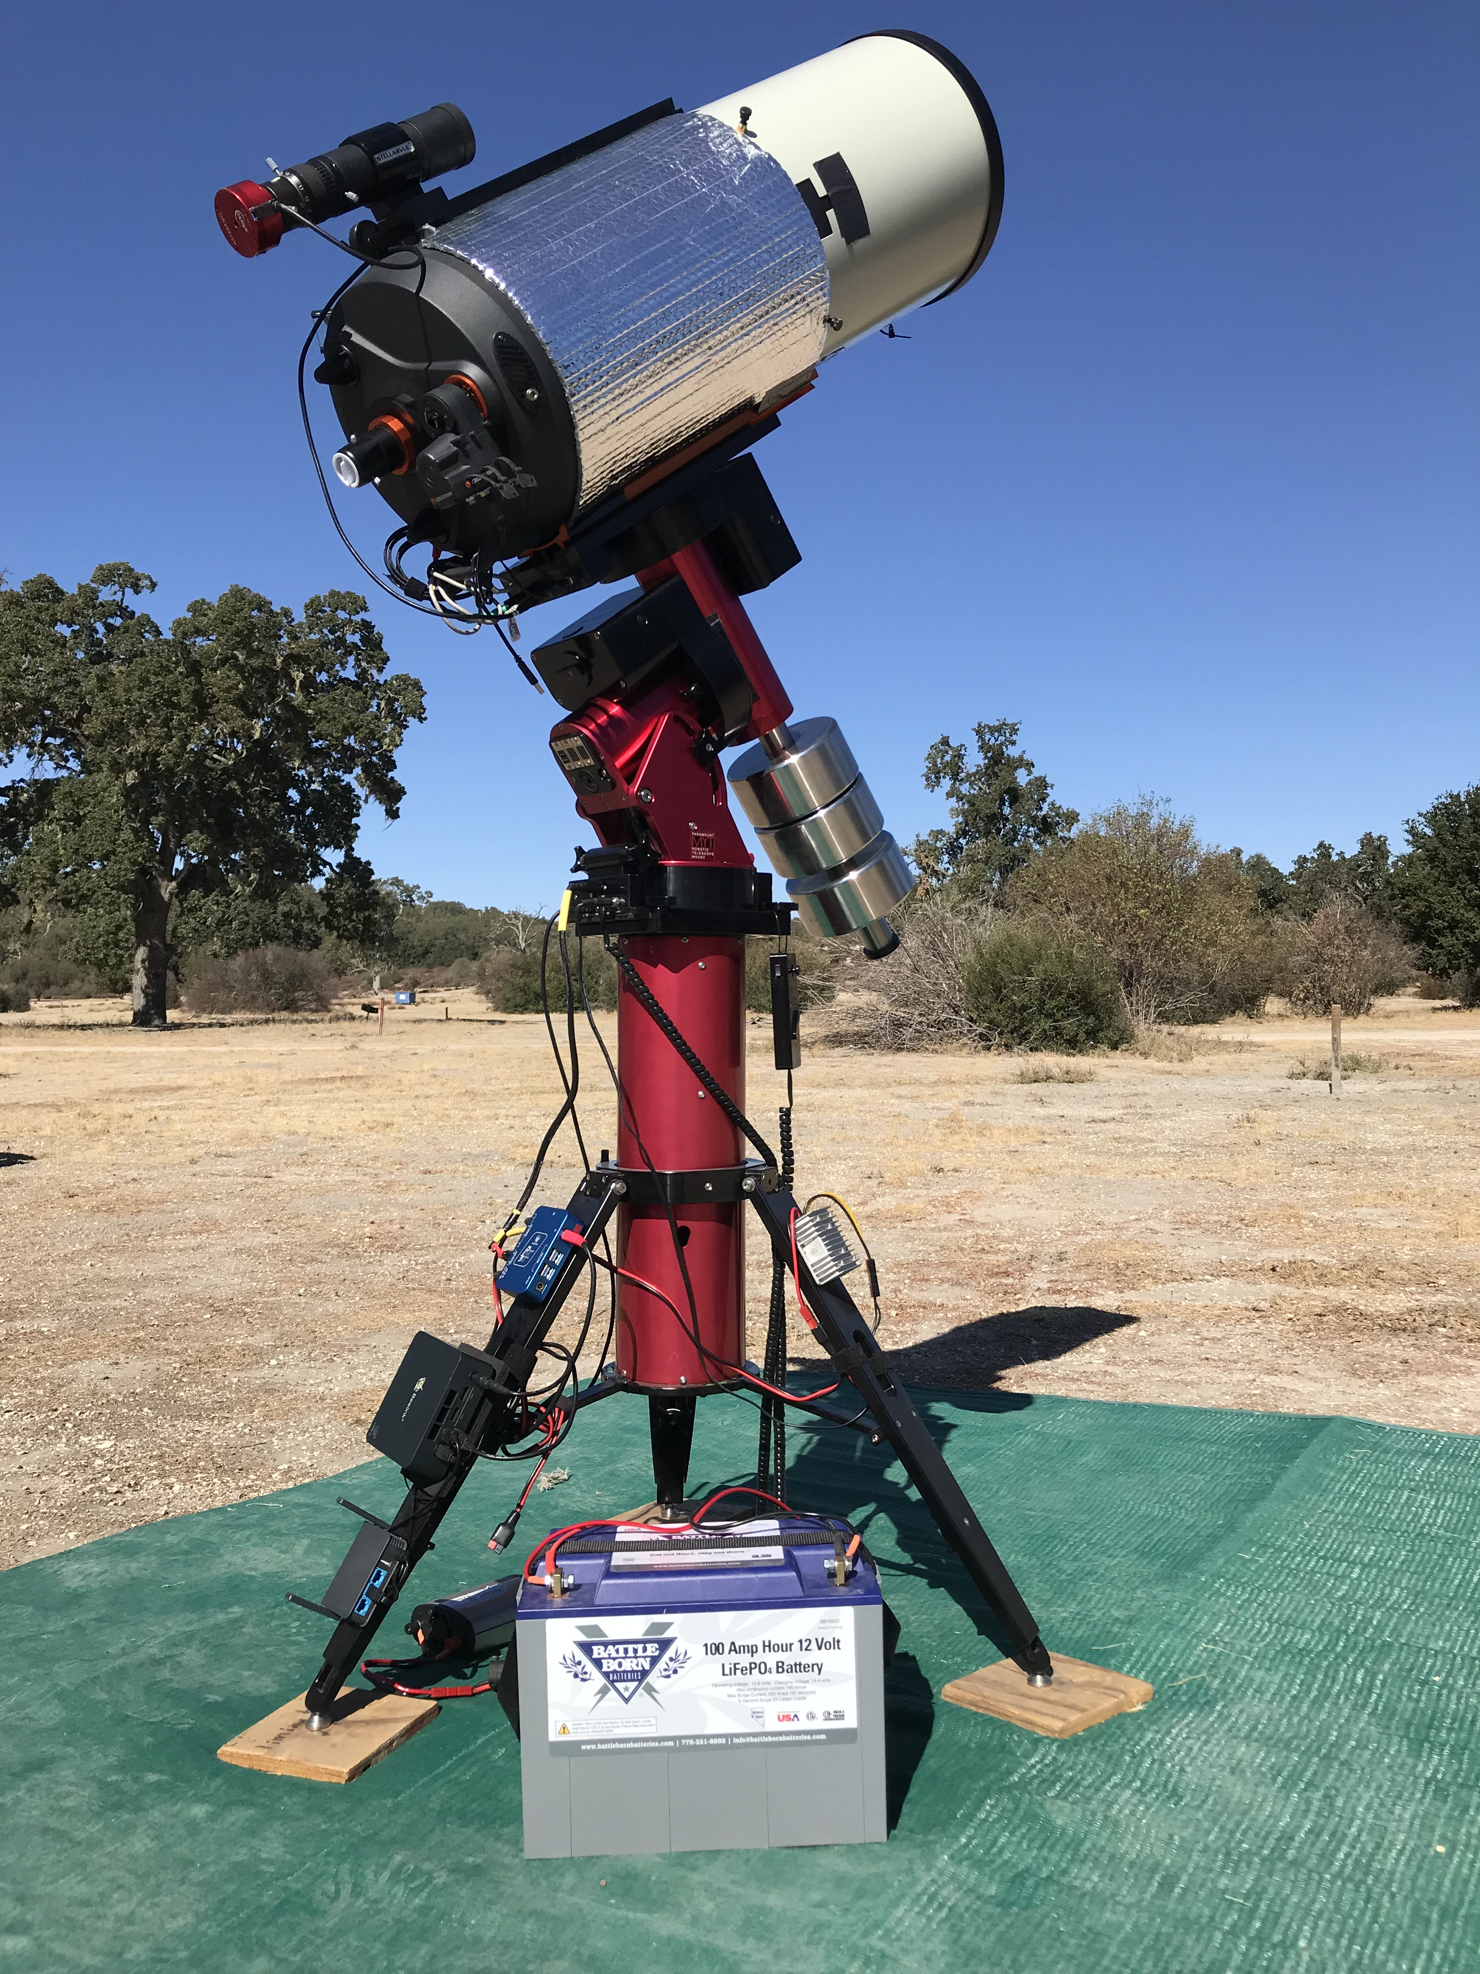
My Quest for Better Power in the Field
  10+ Yrs: Power from lead acid batteries/ gas generator
  2019 -2022 Deep Dive into Lithium Batteries & Solar Charging
    General review of Li battery technology
    Talked with multiple vendors/manufacturers
    Checked battery reviews, ratings, specs
    Toured Battleborn’s Reno, NV factory
    Conducted extensive real world tests of multiple lithium power solutions & solar panels
Jackery 1002Wh Solar
Generator &
Solar Panels
Battleborn
100 Ah LiFePO4 Battery

Slide 3
A Comparison of Lithium vs Lead Acid
Feature | Lithium 100Ah Battery | AGM 100Ah Battery
Lifetime | 10 years | 4-5 years
# Discharge Cycles | >3000 | 450 to 550
Safe Depth of Discharge | 100% | 50 – 60%
Weight | 31 lbs | 63 lbs
Voltage Vs Capacity Curve | Flat | Steep
Battery Management System (BMS) | Yes | No
Charge Rate / Charge Time | 0.5C / 1.0 T | 0.3C / 1.7T
Memory effect | No | Yes
Self-discharge Rate | 2-3% / Month | 4 – 6% / Month
Maintenance | 6 Months | Monthly
Cost | $400 to $800 | $180 to $290
Upfront Cost Per Watt-Hour | $0.31 to $0.62 | $0.23 to $0.38
Lifetime Cost per KiloWatt-Hour | $0.10 to $0.21 | $0.47 to $0.75

Slide 4
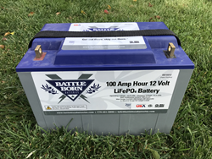

Many Lithium Battery Chemistries
Lithium Cobalt Oxide, LiCoO₂ (ICR)
Lithium Nickel Manganese Cobalt Oxide, LiNiMnCoO₂ (NMC)
Lithium Manganese Oxide, LiMn₂O₄ (LMO)
Lithium Nickle Cobalt Aluminum Oxide, LiNiCoAlO₂ (NCA)
Lithium Iron Phosphate, LiFePO₄ (LFP)
Lithium Titanate, Li₂TiO₃ (LTO)
We will focus the two most relevant to us
  LiFePO₄ - found in most stand alone Lithium batteries and
  some solar generators
  LiNiMnCoO₂ - found in most solar generators

Slide 5


Key Characteristics of LFP & NMC
LiFePO₄ (LFP)
  Very high cycle life >3000 cycles
  Very high thermal runaway temperatures 518º F
  Nominal cell voltage 3.2 to 3.3V –> 4 x 3.2 = 12.8V
  Low specific energy density 90 -120Wh/kg
  Primarily used for RVs, Boats
LiNiMnCoO₂ (NMC)
  Very high specific energy densities 150 – 220Wh/kg
  High thermal runaway temperature 410º F
  Moderate cycle life >500 cycles
  Nominal cell voltage 3.6 to 3.7V -> 4 x 3.6 = 14.4V
  Primarily used for power tools, E-Bikes, Electric Cars, Solar Generators

Slide 6
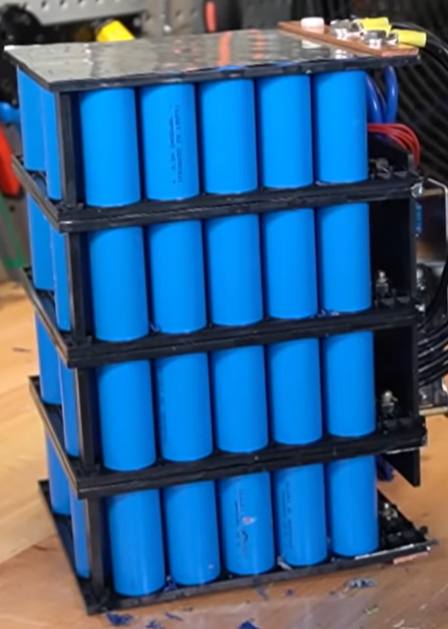
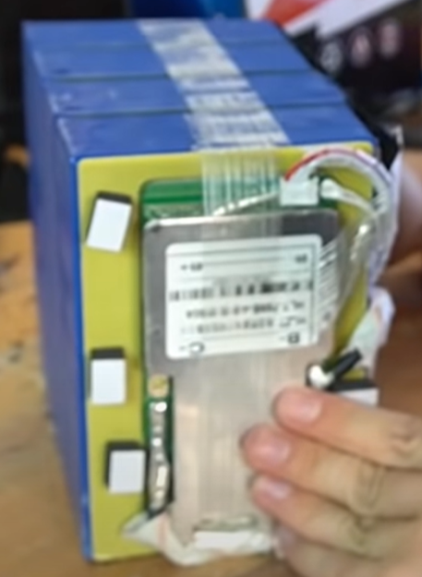
Inside a Lithium Battery: Li Cells
Cylindrical Cells are arranged in series/parallel configuration to obtain the V & Amp-Hr
  Battleborn 100Ah: 120 Cylindrical Cells
  4 (series) x 30 (parallel) =120 cells
  4 x 3.2V / cell = 12.8V 30 x 3.4Ah / cell = 102Ah
Prismatic Cells are arranged in series with fewer cells
  AmpereTime 100Ah: 4 Prismatic Cells
  4 (series) X 3.2V / cell = 12.8V
  1 x 100Ah / cell = 100 Ah

Slide 7
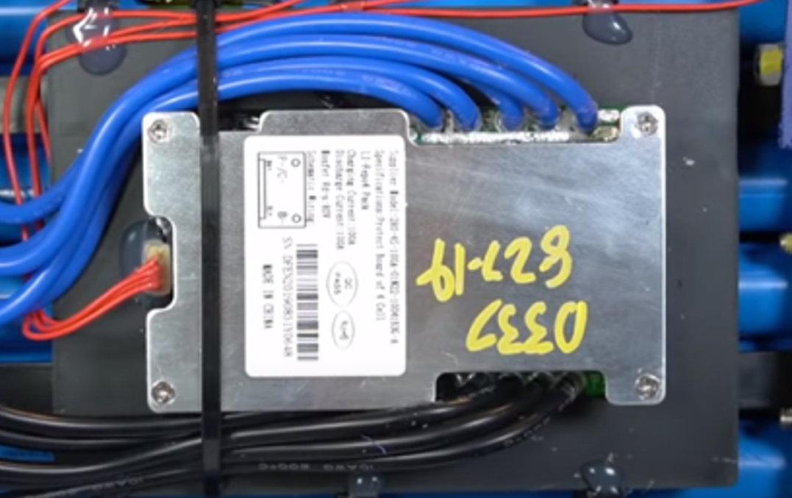
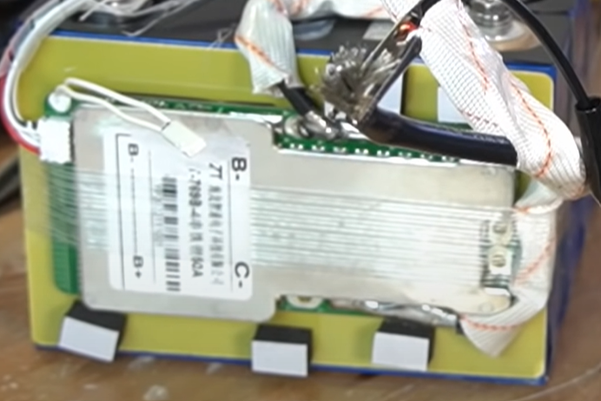
BMS: Key Difference with Lead Acid
Lithium batteries have a battery management system (BMS) inside (if not don’t buy it)
  Function is to manage & protect the battery from unsafe operation:
    Short circuit disconnect
    Overcharging / over discharging protection
    Cell balancing
    Low voltage disconnect – key to allowing 100% DOD without damaging internal cells
    Low temp charging (25 to 32 deg F) & high temp (135 deg F) discharging or discharging
      Requires on board temperature sensor which some batteries do not have
  Not all BMSs are equal: check out Will Prowse’s tear down videos
    Aliexpress 120Ah LiFePO4 Battery https://www.youtube.com/watch?v=OW3QCeWFDys
    Battleborn https://www.youtube.com/watch?v=G5E30u-66VI

Slide 8


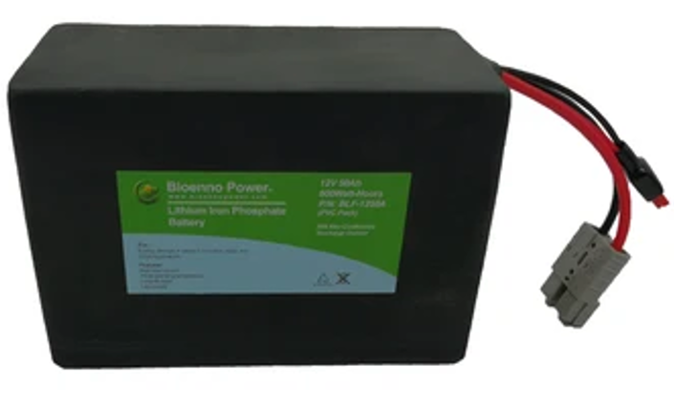

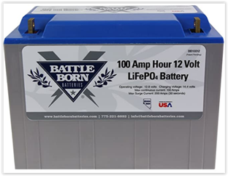
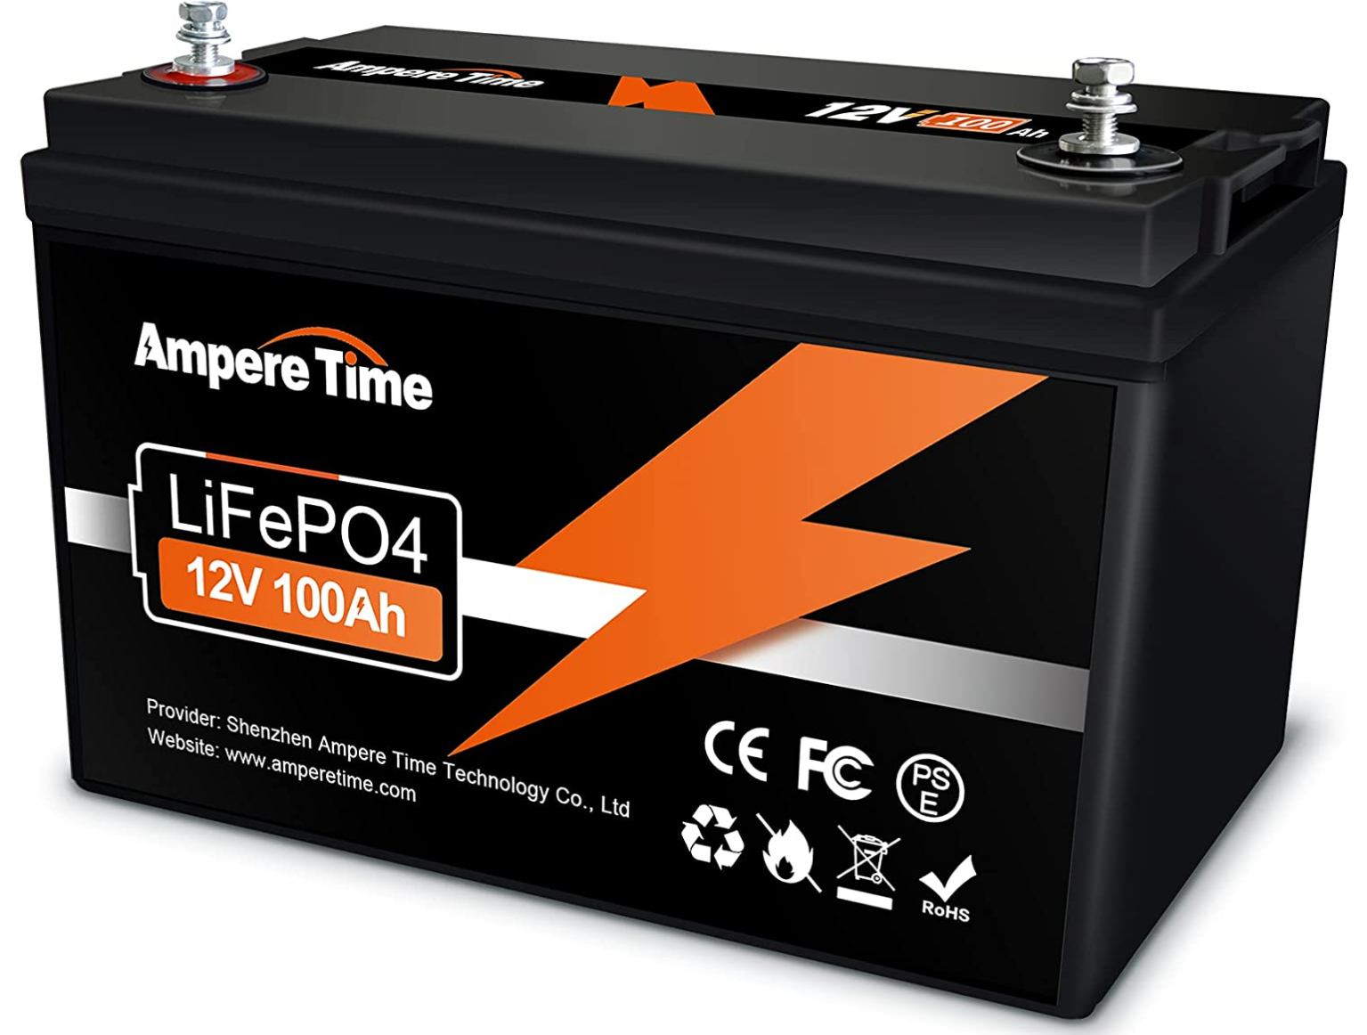
A Plethora of LiFePO4 Battery Choices
Dozens of different options available with a few examples shown in the table below
  Most made and sold through China on Amazon or their manufacturer’s own web site
  Bioenno Power (Santa Ana, CA): Uses a Chinese contract manufacturer
  Battleborn (Reno, NV.): Designed & assembled in the U.S. with cells from Asia
  Lowest cost is not always the best choice, there are trade-offs. Do your homework
Supplier (Cell Type) | Wh | Ah | Max.12V Current | Weight (lbs) | Additional Features | Cost
Talentcell (Cylindrical) | 83.2 | 6.5 | 5A | 1.7 | 1 x 5.5 x 2.1, USB | $59
Celestron Power Tank | 159 | 12.4 | 10 A & 5A | 4.5 | 10A Car, 5A 5.5 x 2.1, 2 x USB | $250
Bioenno Pwr (Cylindrical) | 1280 640 | 100 50 | 100 50 | 28.2 13.3 | Anderson Power Pole Connectors | $862 $470
Expert Power (Prismatic) | 1280 640 | 100 50 | 100A 50A | 22.6 13 | Standard high capacity battery terminals | $600 $400
Battleborn (Cylindrical) | 1280 640 | 100 50 | 100A 50A | 31 17.6 | Standard high capacity battery terminals | $800 $600
AmpereTime (Prismatic) | 1280 640 | 100 50 | 100A 50A | 25.5 11.6 | Standard high capacity battery terminals | $400 $290
Images – Amazon.com, Battelbornbatteries.com, Bioennopower.com, Celestron.com

Slide 9
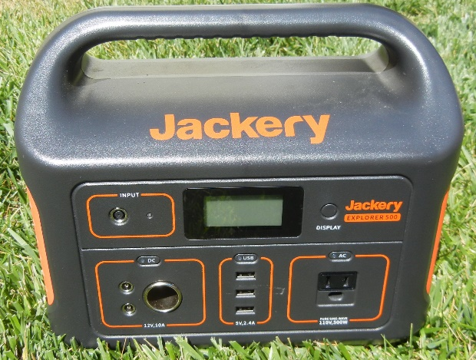
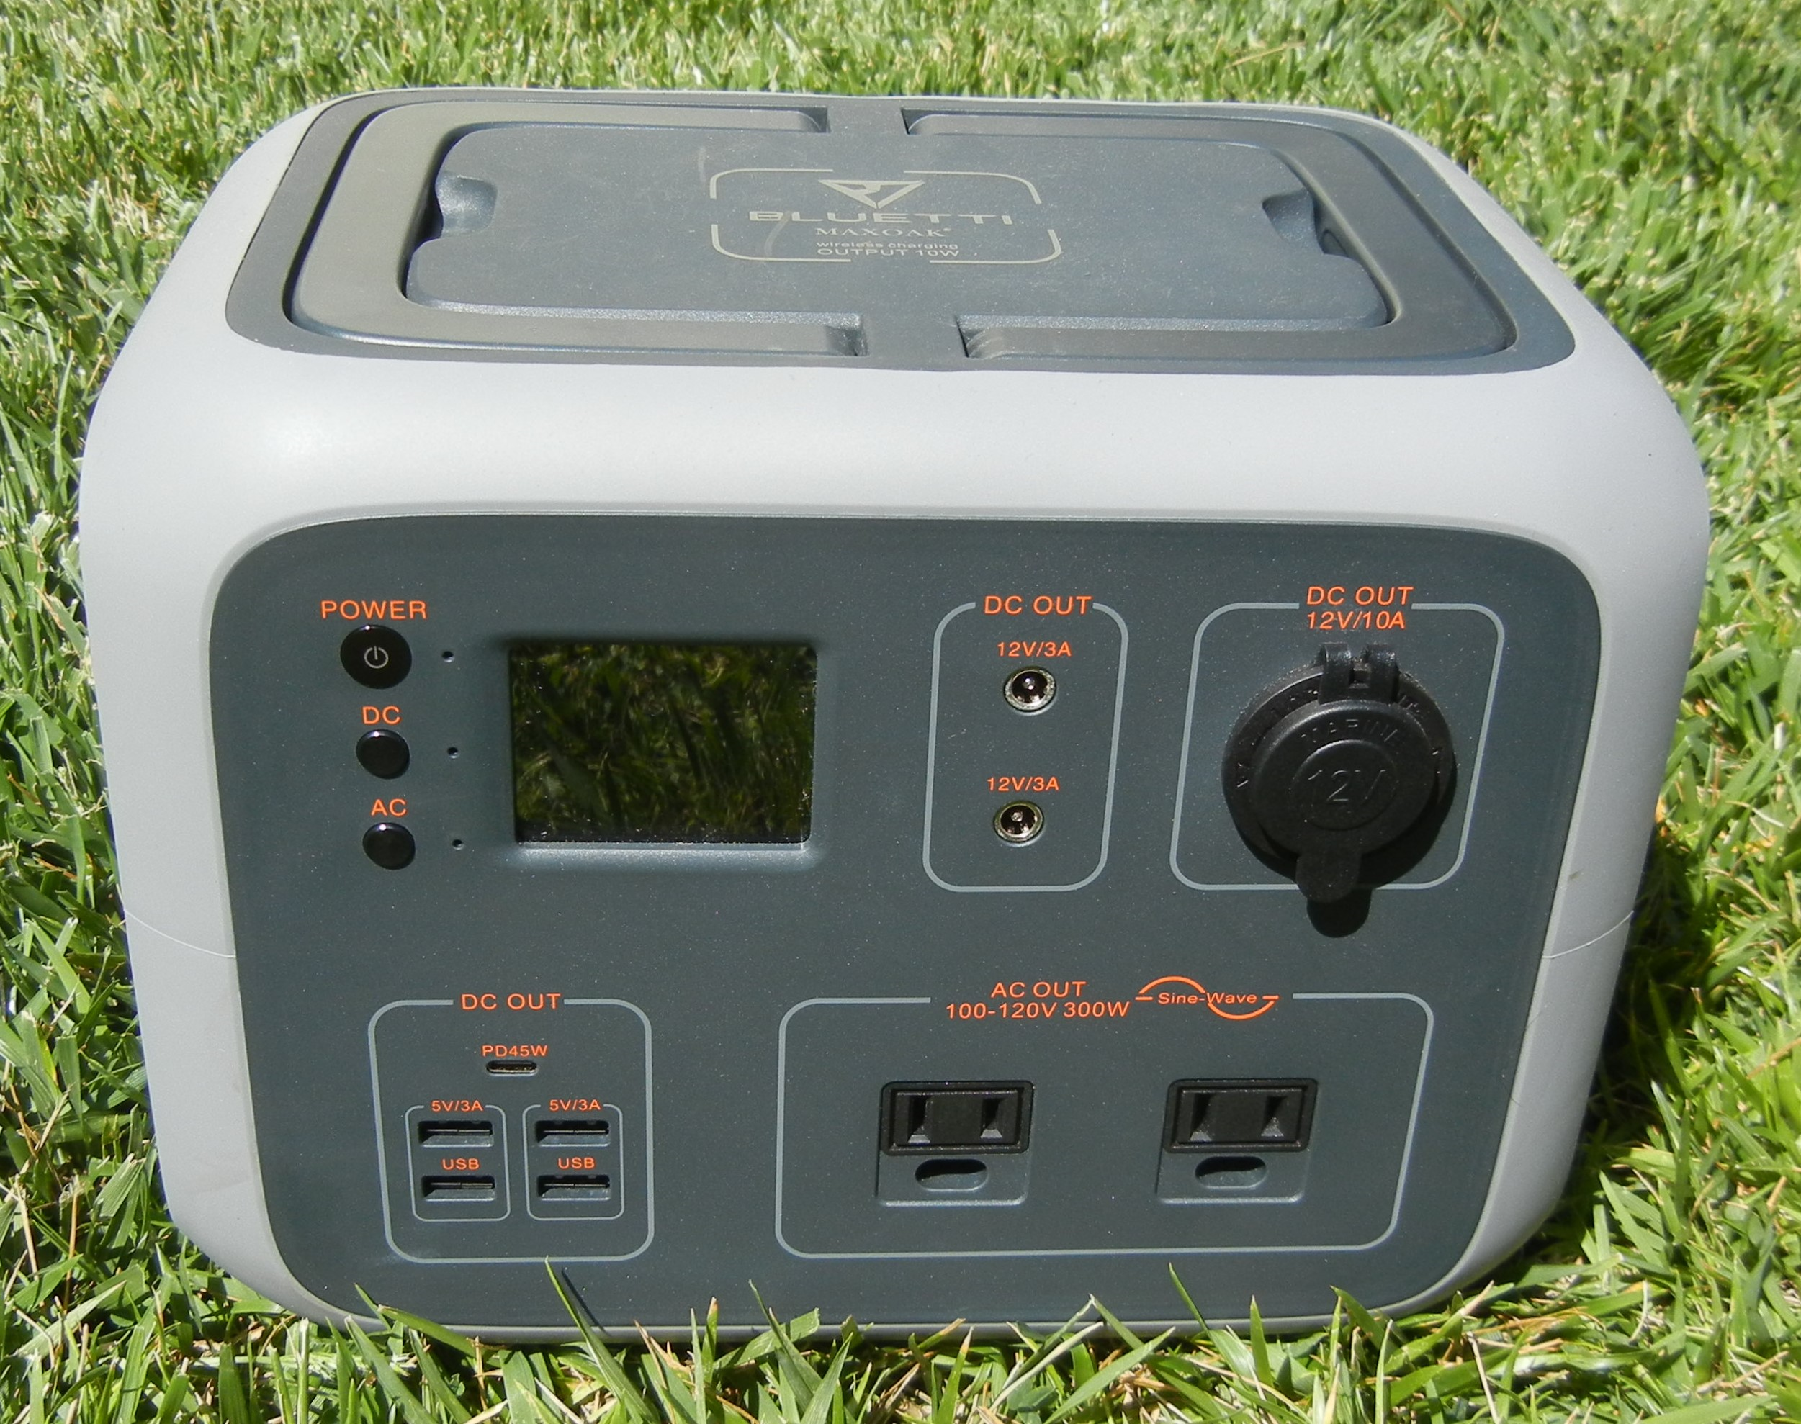

Solar Generators
Solar Generators have many useful built-in features not available on a stand alone battery
  DC power port(s): Voltage regulated 10A DC cigarette socket; May have additional ports
  Pure Sine Wave inverter for AC power with 1 or more ports
  Multiple USB charging ports
  Built in charge controller for solar panel charging
  Display showing the Power and SOC
  BMS to protect and manage the battery cells
  AC wall charger included
Jackery 518Wh
Maxoak Bluetti AC50s 500Wh

Slide 10
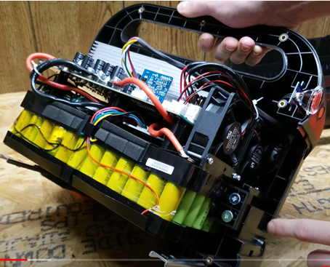
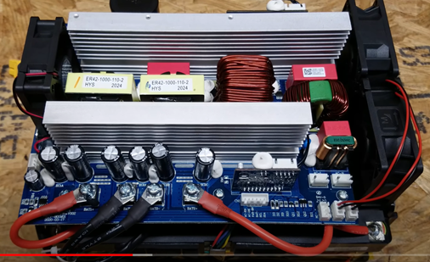
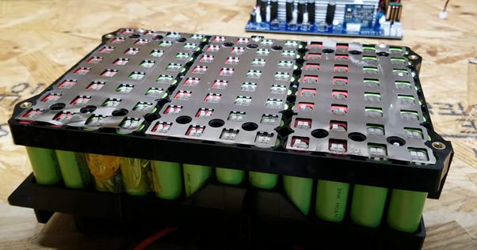
Inside a Lithium Solar Generator
Jackery Explorer 1000
  AC Inverter, Solar Charge Controller
  BMS, Input/Output connections
  Display and meter
  6 (series) x 16 (parallel) = 96 total cells
  6 x 3.6V = 21.6V, hence the voltage regulator → nominal output ~12.8V
  16 x 2.9Ah = 46.4Ah @ 21.6V → 83.5Ah @ 12V
  Link to teardown video https://www.youtube.com/watch?v=AKxt4eAwKRU
AC Inverter
Li Battery Cells

Slide 11

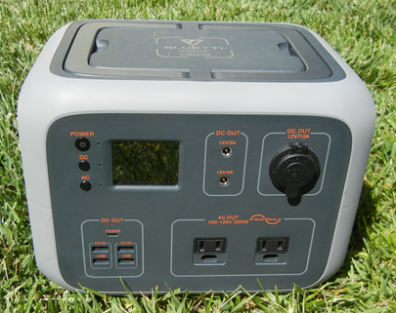

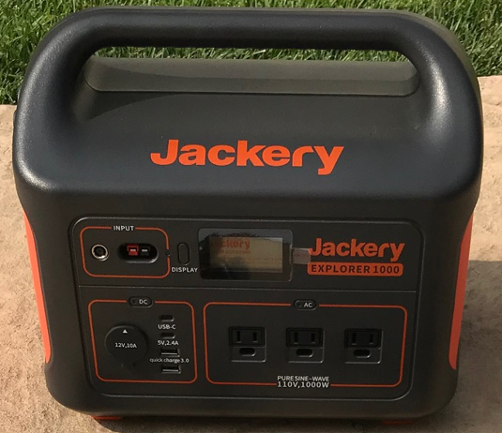
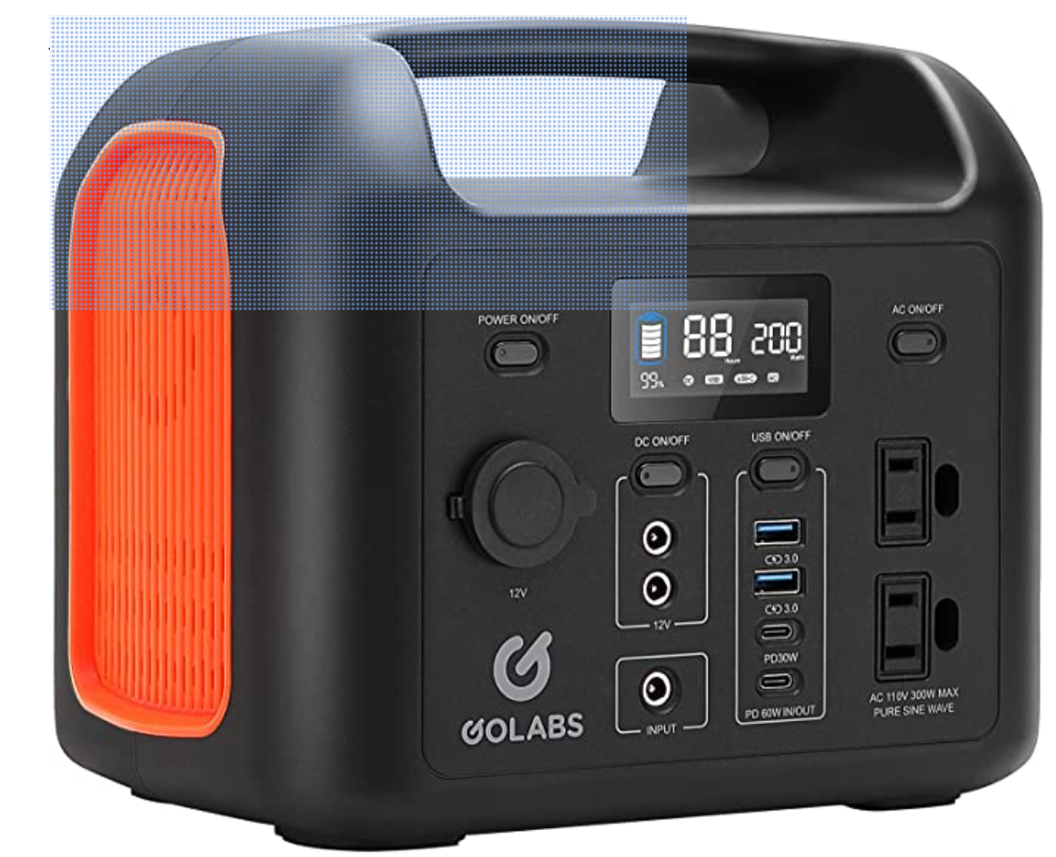
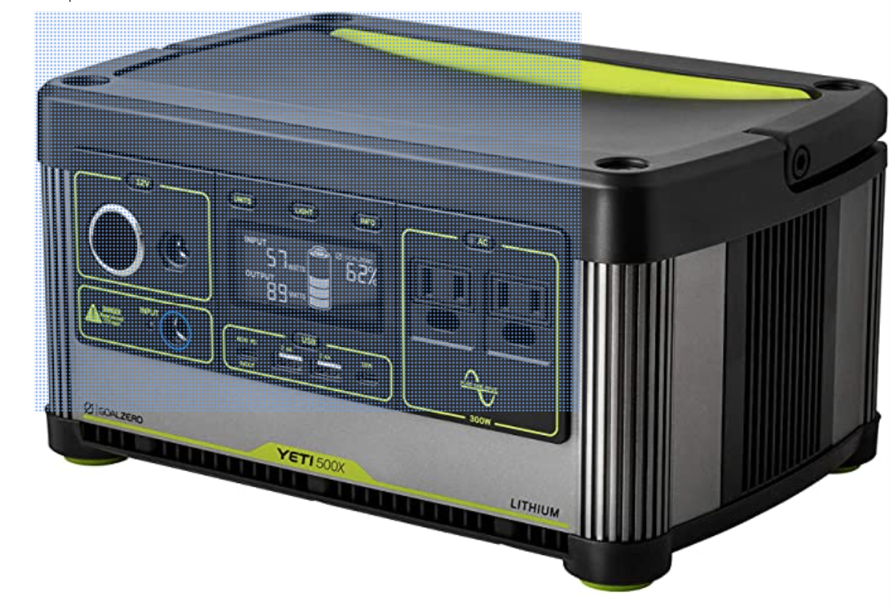
A Plethora of Solar Generators
Dozens of different options available with a few examples shown in the table below
  Most made and sold through China on Amazon or their manufacturer’s own web site
  Jackery & Goal Zero are probably the most well known brands
Supplier (Cell Type) | Wh | Ah | Weight (lbs) | Additional Features | Cost
Meade (NMC) | 222 | 18.5 | 6.3 | 2 AC Ports (100W), 5 x USB 3x 10A 5.5 x 2.1 (10A Total), 2 USB A, 2 USB C | $230
Maxoak Bluetti AC50S (NMC Cyl.) | 500 | 42 | 13.6 | 10A Regulated Cigarette Port, 2 x 5.5 x 2.1mm 3A Ports, 1 AC Port (300W), 4 x USB A, 45W PD Port, Display, Power Meter | $370
Jackery 500 (NMC Cyl.) | 518 | 43 | 13.3 | 10A Regulated Cigarette Port, 2x 3A Regulated DC Ports, 1 AC Port (500W), 3 USBA, Display, Pwr Meter | $530
Jackery 1000 (NMC Cyl.) | 1002 | 83 | 22 | 10A Regulated Cigarette Port, 3 AC Ports (1000W), 2 USBA, 2 USBC, Display, Power Meter | $1100
Golabs R300 (LiFePO4 Cyl.) | 299 | 25 | 10.5 | 10A Unregulated Cigarette Port, 2 x 5.5 x 2.1mm Ports (10A Max)2 AC Ports (300W), 2 USB QC,1 PD 30W, 1 PD 60W Display, Power Meter | $240
Goal Zero Yeti 505Wh (NMC Cyl.) | 505 | 42 | 12.9 | 10A Regulated Cigarette Port, 6mm DC Port, 2 x AC (300W), 2 x USB A, 1 USB C, 1 USB C PD, Display, Power Meter | $700
Images – Amazon.com, Battelbornbatteries.com, Bioennopower.com, Celestron.com

Slide 12
Li Battery vs Li Solar Generator
Feature | Lithium 100Ah Battery | Solar Generator 1002WH
Capacity | 100Ah (1280Wh) | 78Ah (1002Wh)
Lifetime | 10 years | 10 years
# Discharge Cycles | >3000 | >500
Depth of Discharge Without Damage | 100% | 100%
Weight (Normalized to 100Ah) | 31 lbs (31 lbs) | 22 lbs ( 28 lbs)
Voltage Regulation | No | Yes
Battery Management System (BMS) | Yes | Yes
Cigarette Lighter Port | No | Yes
Pure Sine Wave Inverter | No | Yes
USB Ports | No | Yes
Solar Charge Controller | No | Yes
Display & Power Meter | No | Yes
Cost per WH | $0.31 to $0.62 | $1.10
Lifetime Cost per KiloWatt-Hour | $0.10 to $0.21 | $2.20

Slide 13
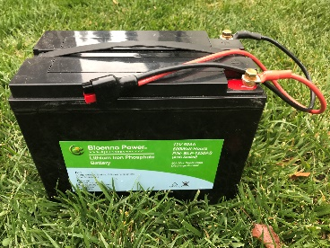
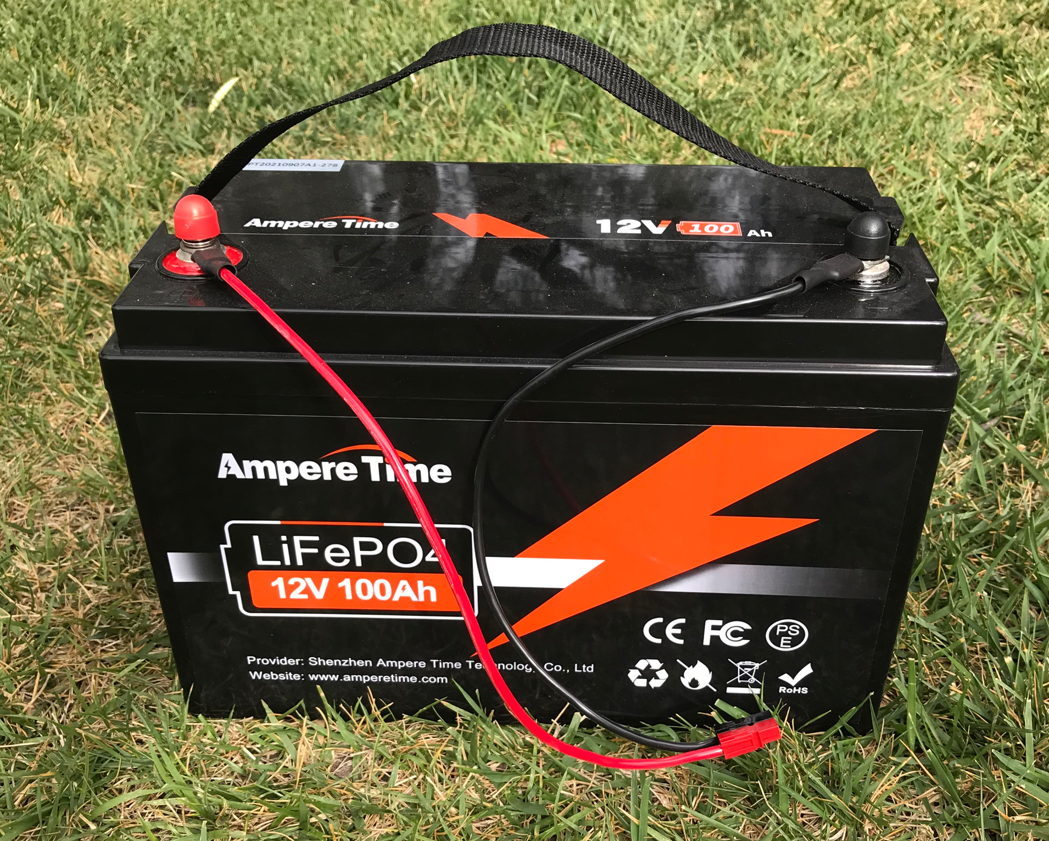
Test Results for 6 Li Power Supplies
LiFePO4 Batteries: Ampere Time, Battleborn & Bioenno Power
Solar Generators: Jackery 1000 & 500, Maxoak Bluetti AC50S 500

Slide 14
1st Test: Actual vs Rated Capacities
Power Source | Rated Ah | Actual Ah | Rated Wh | Actual Wh
Ampere Time | 100 | 103 (103%) | 1280 | 1310 (102%)
Battleborn 100Ah | 100 | 105 (105%) | 1280 | 1356 (106%)
Bioenno 50Ah | 50 | 45 (90%) | 640 | 575 (90%)
Jackery 1000 | 78.6 | 70 (90%) | 1002 | 908 (91%)
Jackery 500 | 40.6 | 42.5 (105%) | 518 | 549 (106%)
Bluetti 500 | 39.2 | 35.4 (90%) | 500 | 465 (93%)
Capacities shown are for V > 12.0V
Average of multiple measurements for each
Battleborn manufactures their batteries to between 104 and 108% of spec
Results for Jackery and Bluetti solar generators are consistent with other reviews

Slide 15
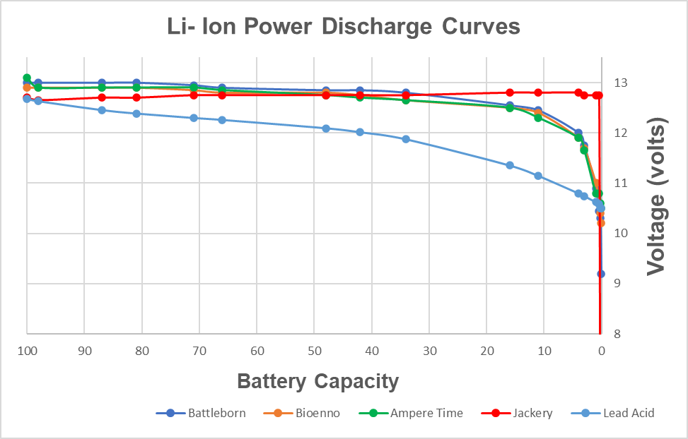
2nd Test: Voltage Discharge vs DOC
Solar Generator maintained a constant voltage of 12.75V at 60W until shut-off
LiFePO4 batteries drop from 12.9V at 60W to 11.9V after 96% DOD
Lead Acid voltage drops to 12.06V at 50% DOD, below 12.0V at ~58% DOD

Slide 16
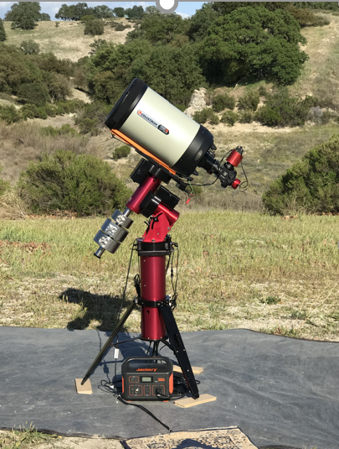
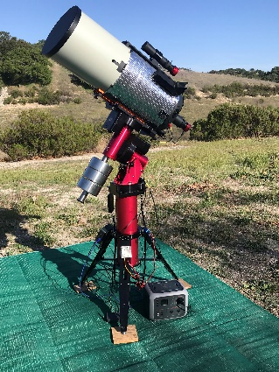
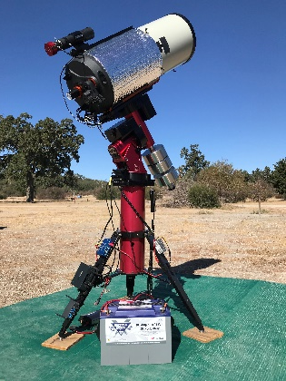
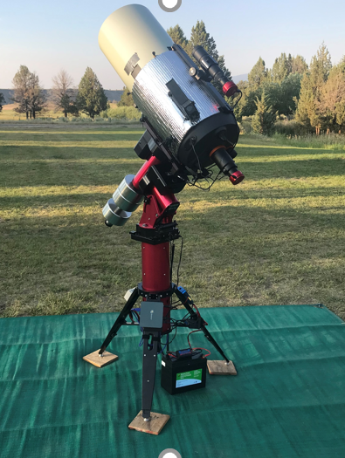
3rd Test: Field Test Setups
  Multiple nights in the field for each Li supply
DC:
    Celestron C11 on Software Bisque MyT mount
      ASI1600MC uncooled camera
      ASI240MC camera
      ASI guide cameras
    Beelink Mini-PC running TSX
    Astrozap 11” dew strap
    Celestron motor focuser; Temp-est Cooling Fans
    Pegaus Power Box Advanced Power/USB Hub
    Gl.iNet Wireless Router
  AC:
    Dell 15” XPS laptop running TSX
    MyT mount powered with its AC supply
      ASI240MC TEC, ASI guide camera & Celestron focuser

Slide 17
Typical Equipment Power Requirements
  Measurements made with a Pegasus Power Box Advanced averaged over ~ 20min each
  Raspberry PI and TheSky Fusion are manufacturer’s estimates
  Currents are shown at 13V, the nominal voltage of my Pyramid regulated power supply

Slide 18
Dark Site Run Time Summary
Equipment Setup | Expected Run Times | Expected Run Times |  | Rated Wh
Equipment Setup | Power Needed | LiFePO4 100Ah | LiFePO4 50Ah | Solar Gen 1000Wh | Sol Gen 500Wh
Rasberry Pi, NUC or Mini-PC, Tracking Mount, Uncooled Camera, Guider, Focuser, Filter Wheel, Powered Hub | 20 – 30W | 67.8 to 45 hrs | 28.8 to 19 hrs | 45.4 to 30.3 hrs | 27.5 to 18.3 hrs
Above + Dew Heater and/or Camera Cooling | 30 – 60W | 45 to 22.6 hrs | 19 to 9.5 hrs | 30.3 to 15.1 hrs | 18.3 to 9.1 hrs
Above + 15.4" Laptop in place of Mini-PC | 60 – 120W | 22.6 to 11 hrs | 9.5 to 4.5 hrs | 15.1 to 7.6 hrs | 9.1 to 4.6 hrs
Power supply size required depends upon # run time hrs per night and # nights before a re-charge is possible
Any of the above supplies will run a 60W load for at least 1 full night

Slide 19
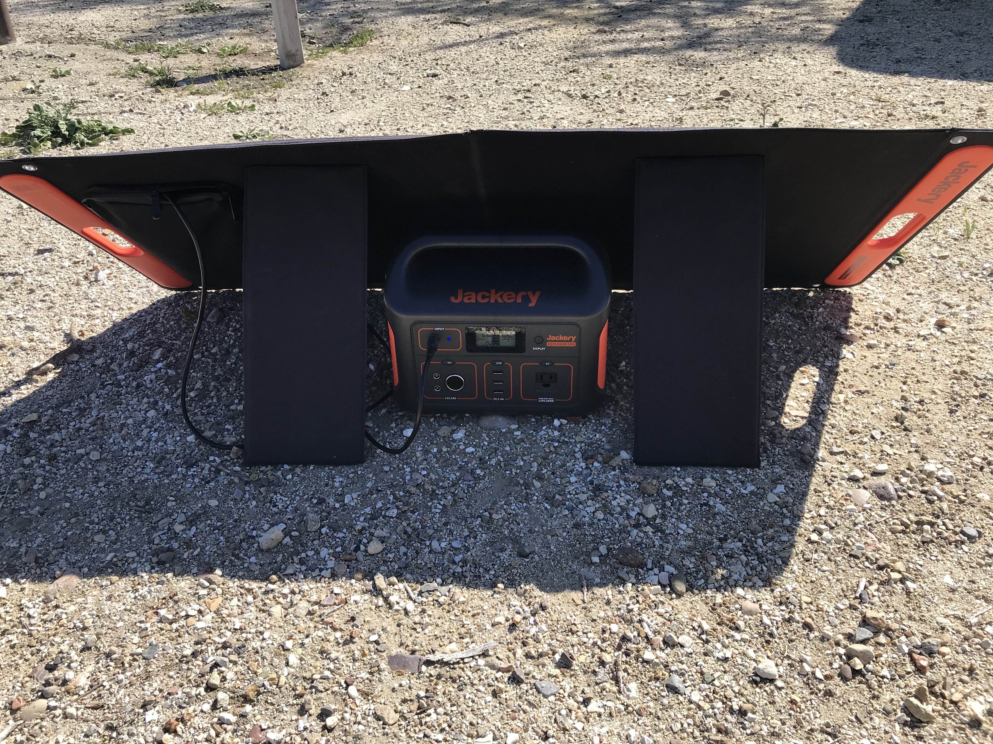
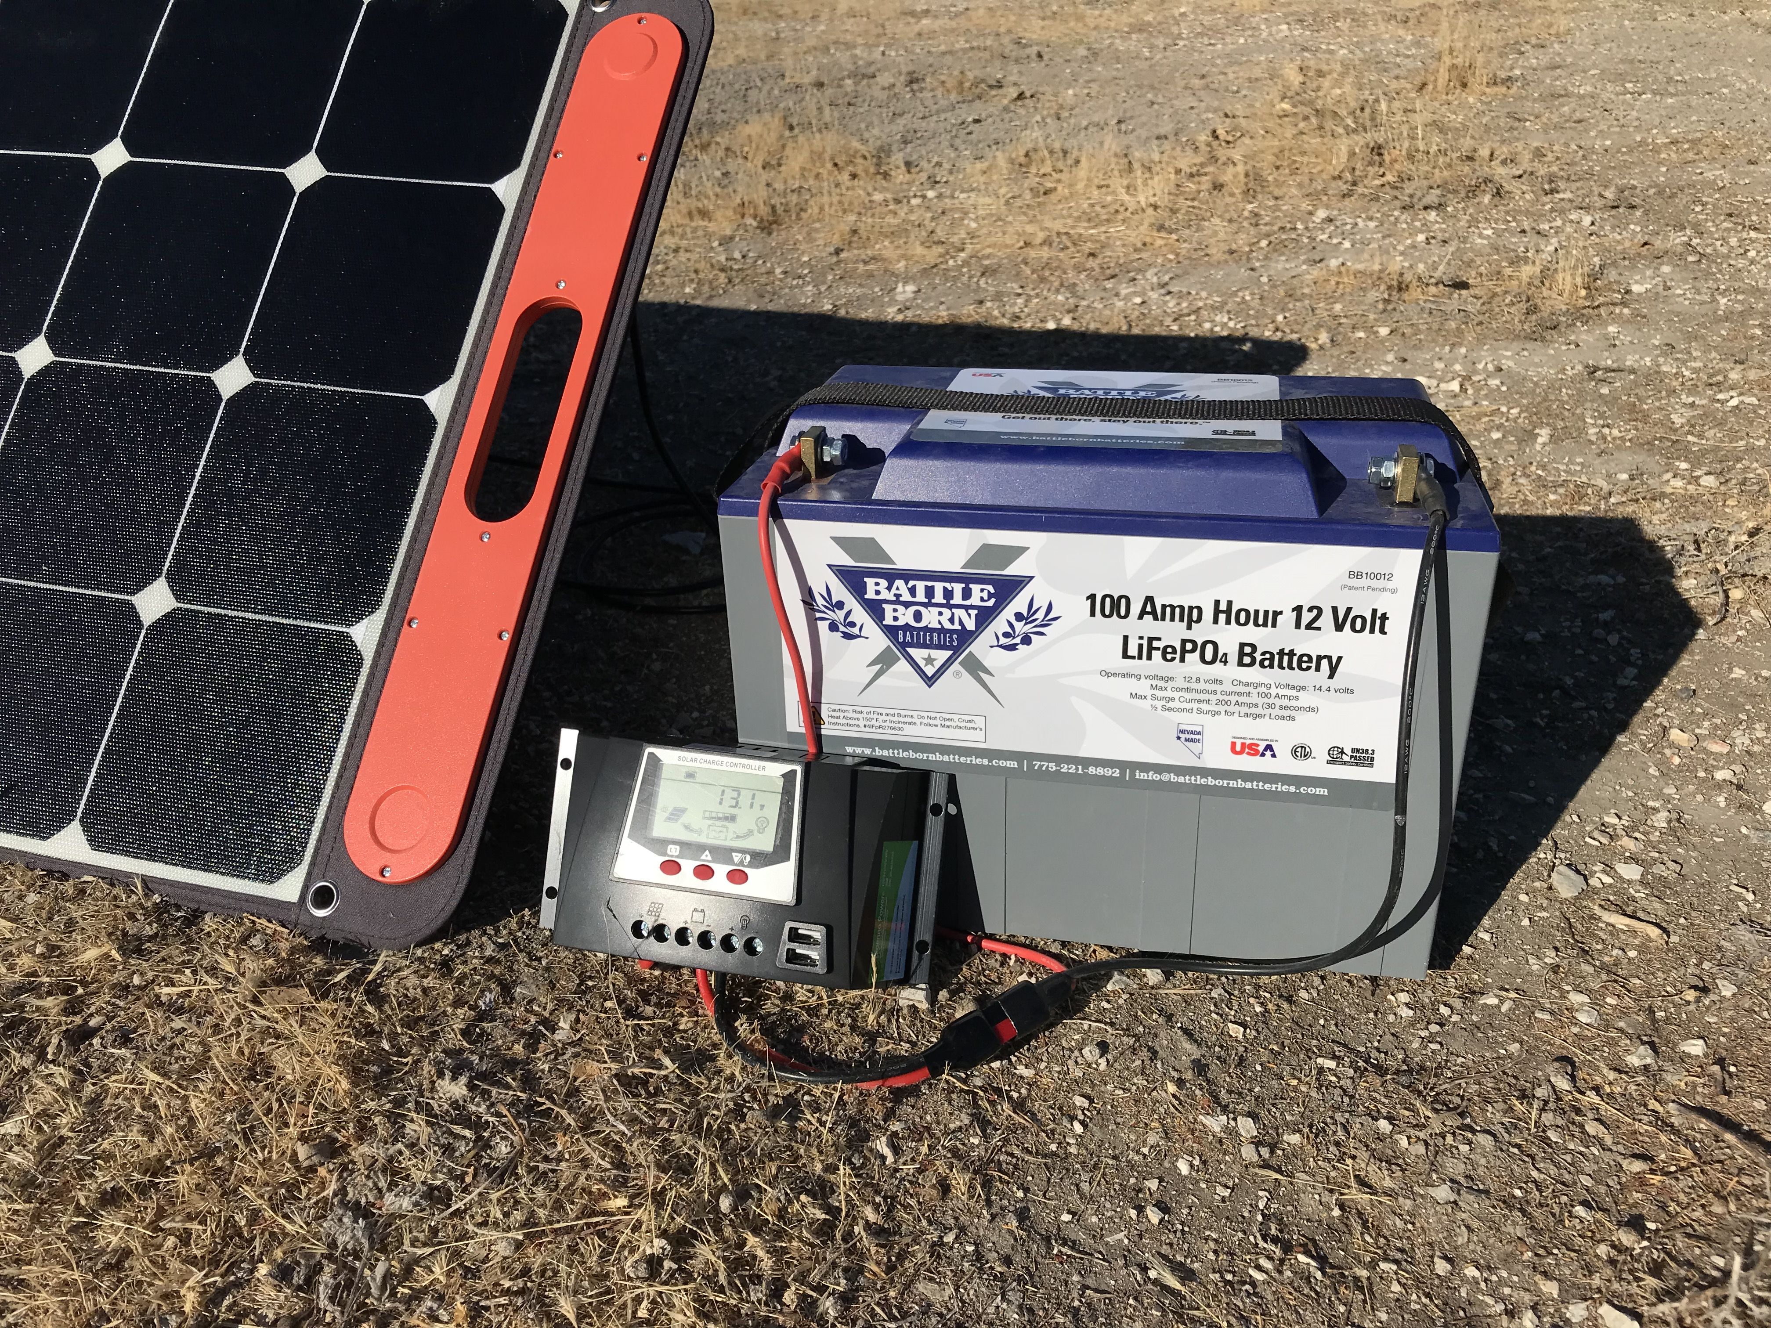
Charging Lithium Power Supplies
Cannot be charged below 25 to 32 deg F nor above 131 deg F (depends on model)
AC
  Solar generators come with an AC charger
  Batteries require a lithium capable charger – different charge profile from lead acid
Solar
  Solar generators only need a solar panel with compatible connector
  Batteries require a lithium capable charge controller, a solar panel and compatible connectors

Slide 20
Full Charge Cycle Test Times
Equipment Setup | 0% SOC to 100% SOC Charging Times (hrs) |  |  | Rated Wh
Equipment Setup | Battleborn 100Ah | Ampere Time 100Ah | Bioenno 50Ah | Jackery 1000 70Ah | Jackery 500 43Ah | Bluetti 500 35Ah
Included AC Charger |  |  |  | 6.5 to 7 | 6.5 to 7 | 7 to 7.5
10A Lithium Charger | 11 | 10.5 | 4.7
100W Solar Panel | 20 |  | 8 | 11 | 9.5 | 6 to 6.5
2 x 100W Solar Panel | 10 | 11 |  | 9.3
100W panel puts out ~5 to 5.5A at 14.6V through a solar charge controller with full sun
  73 to 80W of actual power delivered to the battery
Solar generator re-charge times are limited by their charging circuit current maximum

Slide 21
Lithium Power Equipment Links
  Links are affiliate links where I can earn a small commission at no extra cost to you. This helps support my web site and YouTube channel. Just right click and choose Open Link
  ​LiFePO4 Batteries
  Ampere Time 100Ah
  Battleborn 100Ah
  Bioenno Power 50Ah
  Expert Power 100Ah
  Celestron Power Tank 84.4Wh
  Celestron Power Tank Pro 158.7Wh, 12.4Ah
  Meade LXPS 18- 18Ah
  Talentcell 6.5Ah, 83.2 Wh

Slide 22
Lithium Power Equipment Links
  Links are affiliate links where I can earn a small commission at no extra cost to you. This helps support my web site and YouTube channel.
  Lithium-Ion Solar Generators
  Jackery - Complete line of Solar generators from 160Wh (13.9Ah) to 2060Wh (158.5Ah)
  Bluetti AC50S - 500Wh solar generator
  LiFePO4 AC-DC Chargers
  Ampere Time - 10A
  Ampere Time - 20A
  Bioenno Power - 10A with Anderson Power Pole Connectors
  Bioenno Power - 10A with Anderson Power Pole Connectors & Alligator Clip Adaptors
  Solar Panels
  Jackery Solar Saga - 100W Solar Panel

Slide 23
Wrap Up
  Lead acid batteries work but are no longer the best choice
  Lithium batteries with their many advantages are gaining traction fast
  Solar Generators are more expensive than simple Li battery, but provide significantly more features

Slide 24
More Information
  You can find more detailed information on Li power supplies along with reviews and step by step guides for using them on both my web site and my YouTube channel
  Web Site: https://www.californiaskys.com/
  YouTube Channel: Astronomy Tips & Reviews with Curtis M https://www.youtube.com/channel/UCrOajROPNMvJqJp_gNr2RmA?app=desktop
  You will also find guides for the following on my web site & YouTube channel:
  Guide to measuring the power used by your own equipment
  Guide to using DC-DC voltage converters to go from 12V to 19V (Intel NUC/mini-pc), 48V (SB mounts), 7.4V (DSLR)
  Guide to setting up a wireless WiFi connection to your telescope & mount
  A Beginers Guide to Electronically Assisted Astronomy

Slide 25
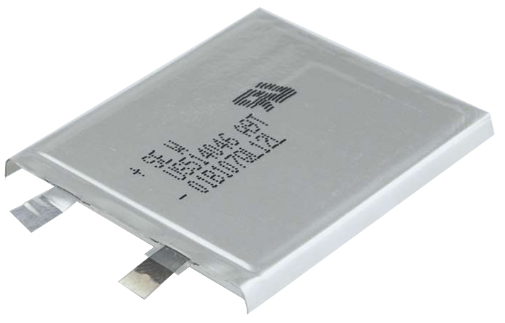

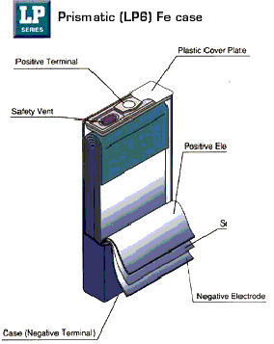

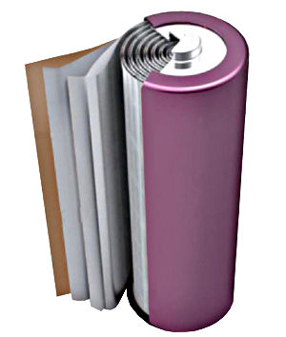
3 Basic Lithium Cell Package Types
Polymer Pouch Cells
  Foil pouch, thin profile, highest packing efficiency
  Phones, Laptops, Tablets, Chevy Volt
Prismatic Cells
  Strong welded case, difficult to manufacture consistently
  High packing efficiency but poor thermal management
  Large capacity per cell requires fewer cells
  Harder to balance cells, single cell failure catastrophic
  Phones, Laptops, Tablets, LiFePO4 batteries
Cylindrical Cells
  Cheapest to manufacture, automated/consistent process
  Lower packing efficiency but good thermal management
  Easy to balance cells, single cell failure has minimal impact
  Power tools, E-Bikes, Medical, Tesla, LiFePO4 batteries &
  NMC solar generators

Slide 26
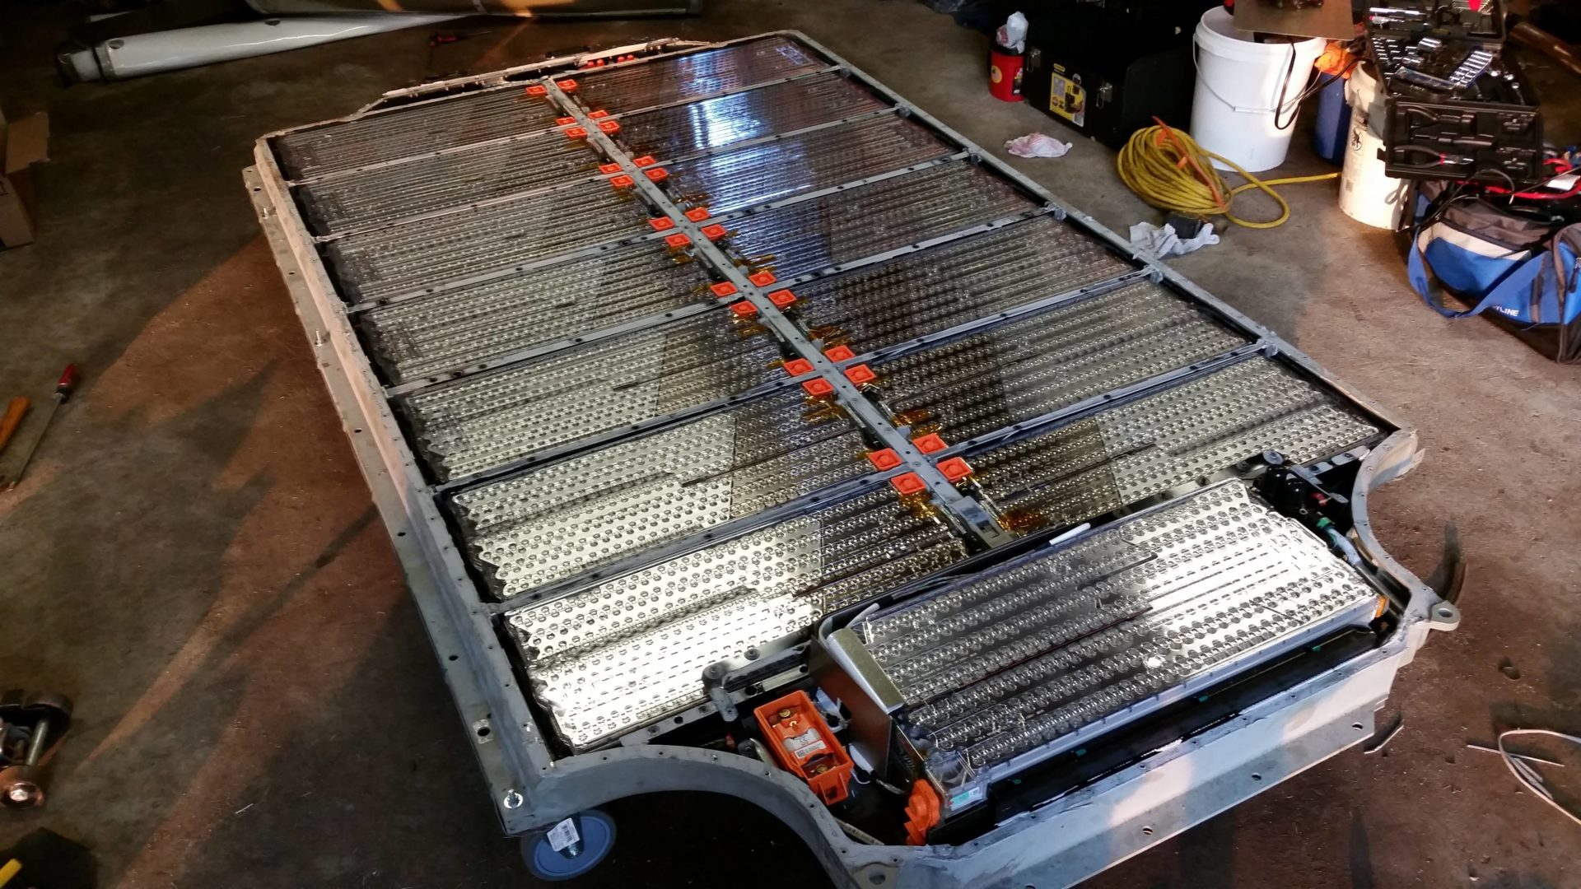
Tesla Battery Cells
Image from https://www.easyelectriccars.com

